Slide 1
PROBLEM SOLVING AND COMPUTER PROGRAMMING
:
Sorting

Slide 2
Sorting the given numbers using selection sort
Definition – Sorting refers to the operation of arranging data in some given order, such as increasing or decreasing with numerical data, or alphabetically with character data.
Selection sort –
The algorithm divides the input list into two parts:
    The sublist of items already sorted
    The sublist of items remaining to be sorted
Idea - The algorithm proceeds by finding the smallest (or largest, depending on sorting order) element in the unsorted sublist, exchanging it with the leftmost unsorted element (putting it in sorted order), and moving the sublist boundaries one element to the right.

Slide 3
Example - Sorting the given numbers using selection sort
64 25 12 22 11 // this is the initial, starting state of the array
11 25 12 22 64 // sorted sublist = {11}
11 12 25 22 64 // sorted sublist = {11, 12}
11 12 22 25 64 // sorted sublist = {11, 12, 22}
11 12 22 25 64 // sorted sublist = {11, 12, 22, 25}
11 12 22 25 64 // sorted sublist = {11, 12, 22, 25, 64}

Slide 4
Algorithm - Sorting the given numbers using selection sort
Algorithm -
  int a[100] ; //declare array a of size 100
  Input n // n is used to sort how many numbers
  Let m = n, i = 1;
  while i is less than or equal to n
    Read a[i];
  Let i = 1;
  while i is less than or equal to n
    Find the index j of the smallest element in a from i^{th} element to n^{th} element
    swap the elements of a[i] and a[j].
    i = i + 1;
  Output a[1] to a[n]

Slide 5
Logic- Sorting the given numbers using selection sort
        for(i=0;i<n-1;i++)
        {
        min=a[i];
        loc=i;
        for(j=i+1;j<n;j++)
        {
        if(min>a[j])
        {
        min=a[j];
        loc=j;
        }
        }
        temp=a[i];
        a[i]=a[loc];
        a[loc]=temp;
        }

Slide 6
        #include<iostream>
        using namespace std;
        int main()
        {
        int i,j,n,loc,temp,min,a[30];
        cout<<"Enter the number of elements:";
        cin>>n;
        cout<<"\nEnter the elements\n";
        for(i=0;i<n;i++)
        cin>>a[i];
        for(i=0;i<n-1;i++)
        {
        min=a[i];
        loc=i;
        for(j=i+1;j<n;j++)
        {
        if(min>a[j])
        {
        min=a[j];
        loc=j;
        }
        }
        temp=a[i];
        a[i]=a[loc];
        a[loc]=temp;
        }
        cout<<"\nSorted list is as follows\n";
        for(i=0;i<n;i++)
        cout<<a[i]<<" ";
        return 0;
        }

Slide 7
Sorting the given numbers using bubble sort
Idea - Repeatedly move the largest element to the highest index
position of the array.
Bubble sort –
The algorithm does two steps:
    Starts at one end of the array and make repeated scans through the list comparing successive pairs of elements.
    If the first element is larger than the second, called an inversion, then the values are swapped.
Idea – the algorithm works by repeatedly stepping through the list to be sorted, comparing each pair of adjacent items and swapping them if they are in the wrong order. The pass through the list is repeated until no swaps are needed.

Slide 8
Example - Sorting the given numbers using Bubble Sort
3 5 2 6 8 1 9
3 5 2 6 8 1 9
3 2 5 6 8 1 9
3 2 5 6 8 1 9
3 2 5 6 8 1 9
3 2 5 6 1 8 9
2 3 5 6 1 8 9
2 3 5 6 1 8 9
2 3 5 6 1 8 9
2 3 5 1 6 8 9
2 3 5 1 6 8 9
2 3 5 1 6 8 9
2 3 1 5 6 8 9
2 3 1 5 6 8 9
2 1 3 5 6 8 9
1 2 3 5 6 8 9

Slide 9
Logic – Bubble Sort
for(i=0;i<n-1;i++)
{
for(j=0;j<n-i-1;j++)
{
if(arr[j]>arr[j+1])
{
int temp=arr[j];
arr[j]=arr[j+1];
arr[j+1]=temp;
} }
}

Slide 10
        #include<stdio.h>
        using namespace std;
        int main()
        {
        int n;
        cout<<"Enter number of element you want to store: ";
        cin>>n;
        int arr[n],i,j;
        cout<<"Enter array values:\n";
        for(i=0;i<n;i++) cin>>arr[i];
        for(i=0;i<n-1;i++)
        {
        for(j=0;j<n-i-1;j++)
        {
        if(arr[j]>arr[j+1])
        {
        int temp=arr[j];
        arr[j]=arr[j+1];
        arr[j+1]=temp;
        }
        }
        }
        cout<<"After Bubble sort the array is:\n";
        for(i=0;i<n;i++)
        cout<<arr[i]<<" ";
        return 0;
        }

Slide 11
Insertion Sort - Example
Example: a[] = {3, 7, 4, 9, 5, 2, 6, 1}.
In each step, the key under consideration is underlined.
3 7 4 9 5 2 6 1
3 7 4 9 5 2 6 1
3 7 4 9 5 2 6 1
3 4 7 9 5 2 6 1
3 4 7 9 5 2 6 1
3 4 5 7 9 2 6 1
2 3 4 5 7 9 6 1
2 3 4 5 6 7 9 1
1 2 3 4 5 6 7 9

Slide 12
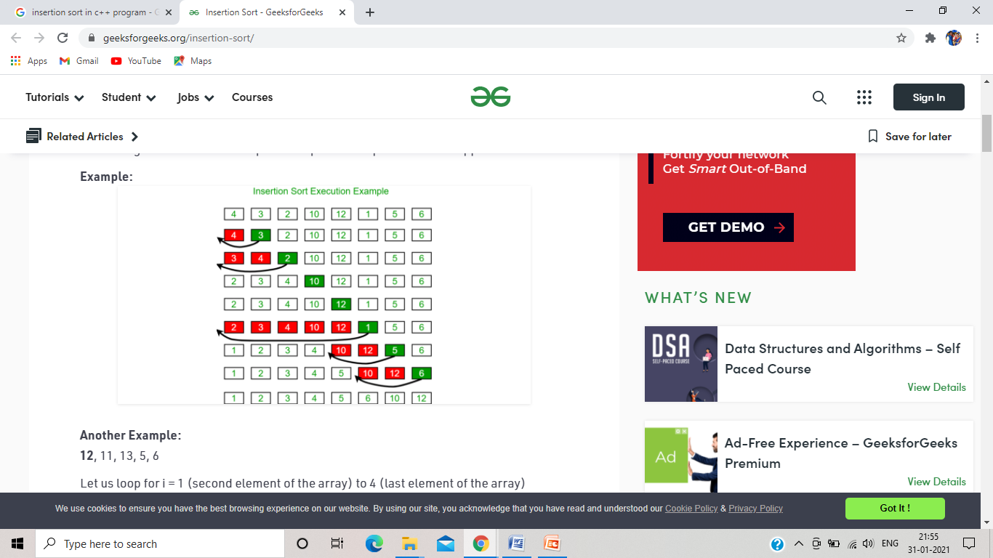

Slide 13
Logic – Insertion Sort
for(i=1;i<=n-1;i++)
{
temp=a[i];
j=i-1;
while((temp<a[j])&&(j>=0))
{
a[j+1]=a[j]; //moves element forward
j=j-1;
}
a[j+1]=temp; //insert element in proper place
}

Slide 14
      #include<iostream>
      using namespace std;
      int main()
      {
      int i,j,n,temp,a[30];
      cout<<"Enter the number of elements:";
      cin>>n;
      cout<<"\nEnter the elements\n";
      for(i=0;i<n;i++) cin>>a[i];
      for(i=1;i<=n-1;i++)
      {
      temp=a[i];
      j=i-1;
      while((temp<a[j])&&(j>=0))
      {
      a[j+1]=a[j]; //moves element forward
      j=j-1;
      }
      a[j+1]=temp; //insert element in proper place
      }
      cout<<"\nSorted list is as follows\n";
      for(i=0;i<n;i++) cout<<a[i]<<" ";
      return 0;
      }

